Slide 1

Linking Wearable Data to Lifestyle Patterns and Health Outcomes
Alex Fout, Mark Gardner, Mantautas Rimkus, Claudia Santillan-Lensink

Slide 2
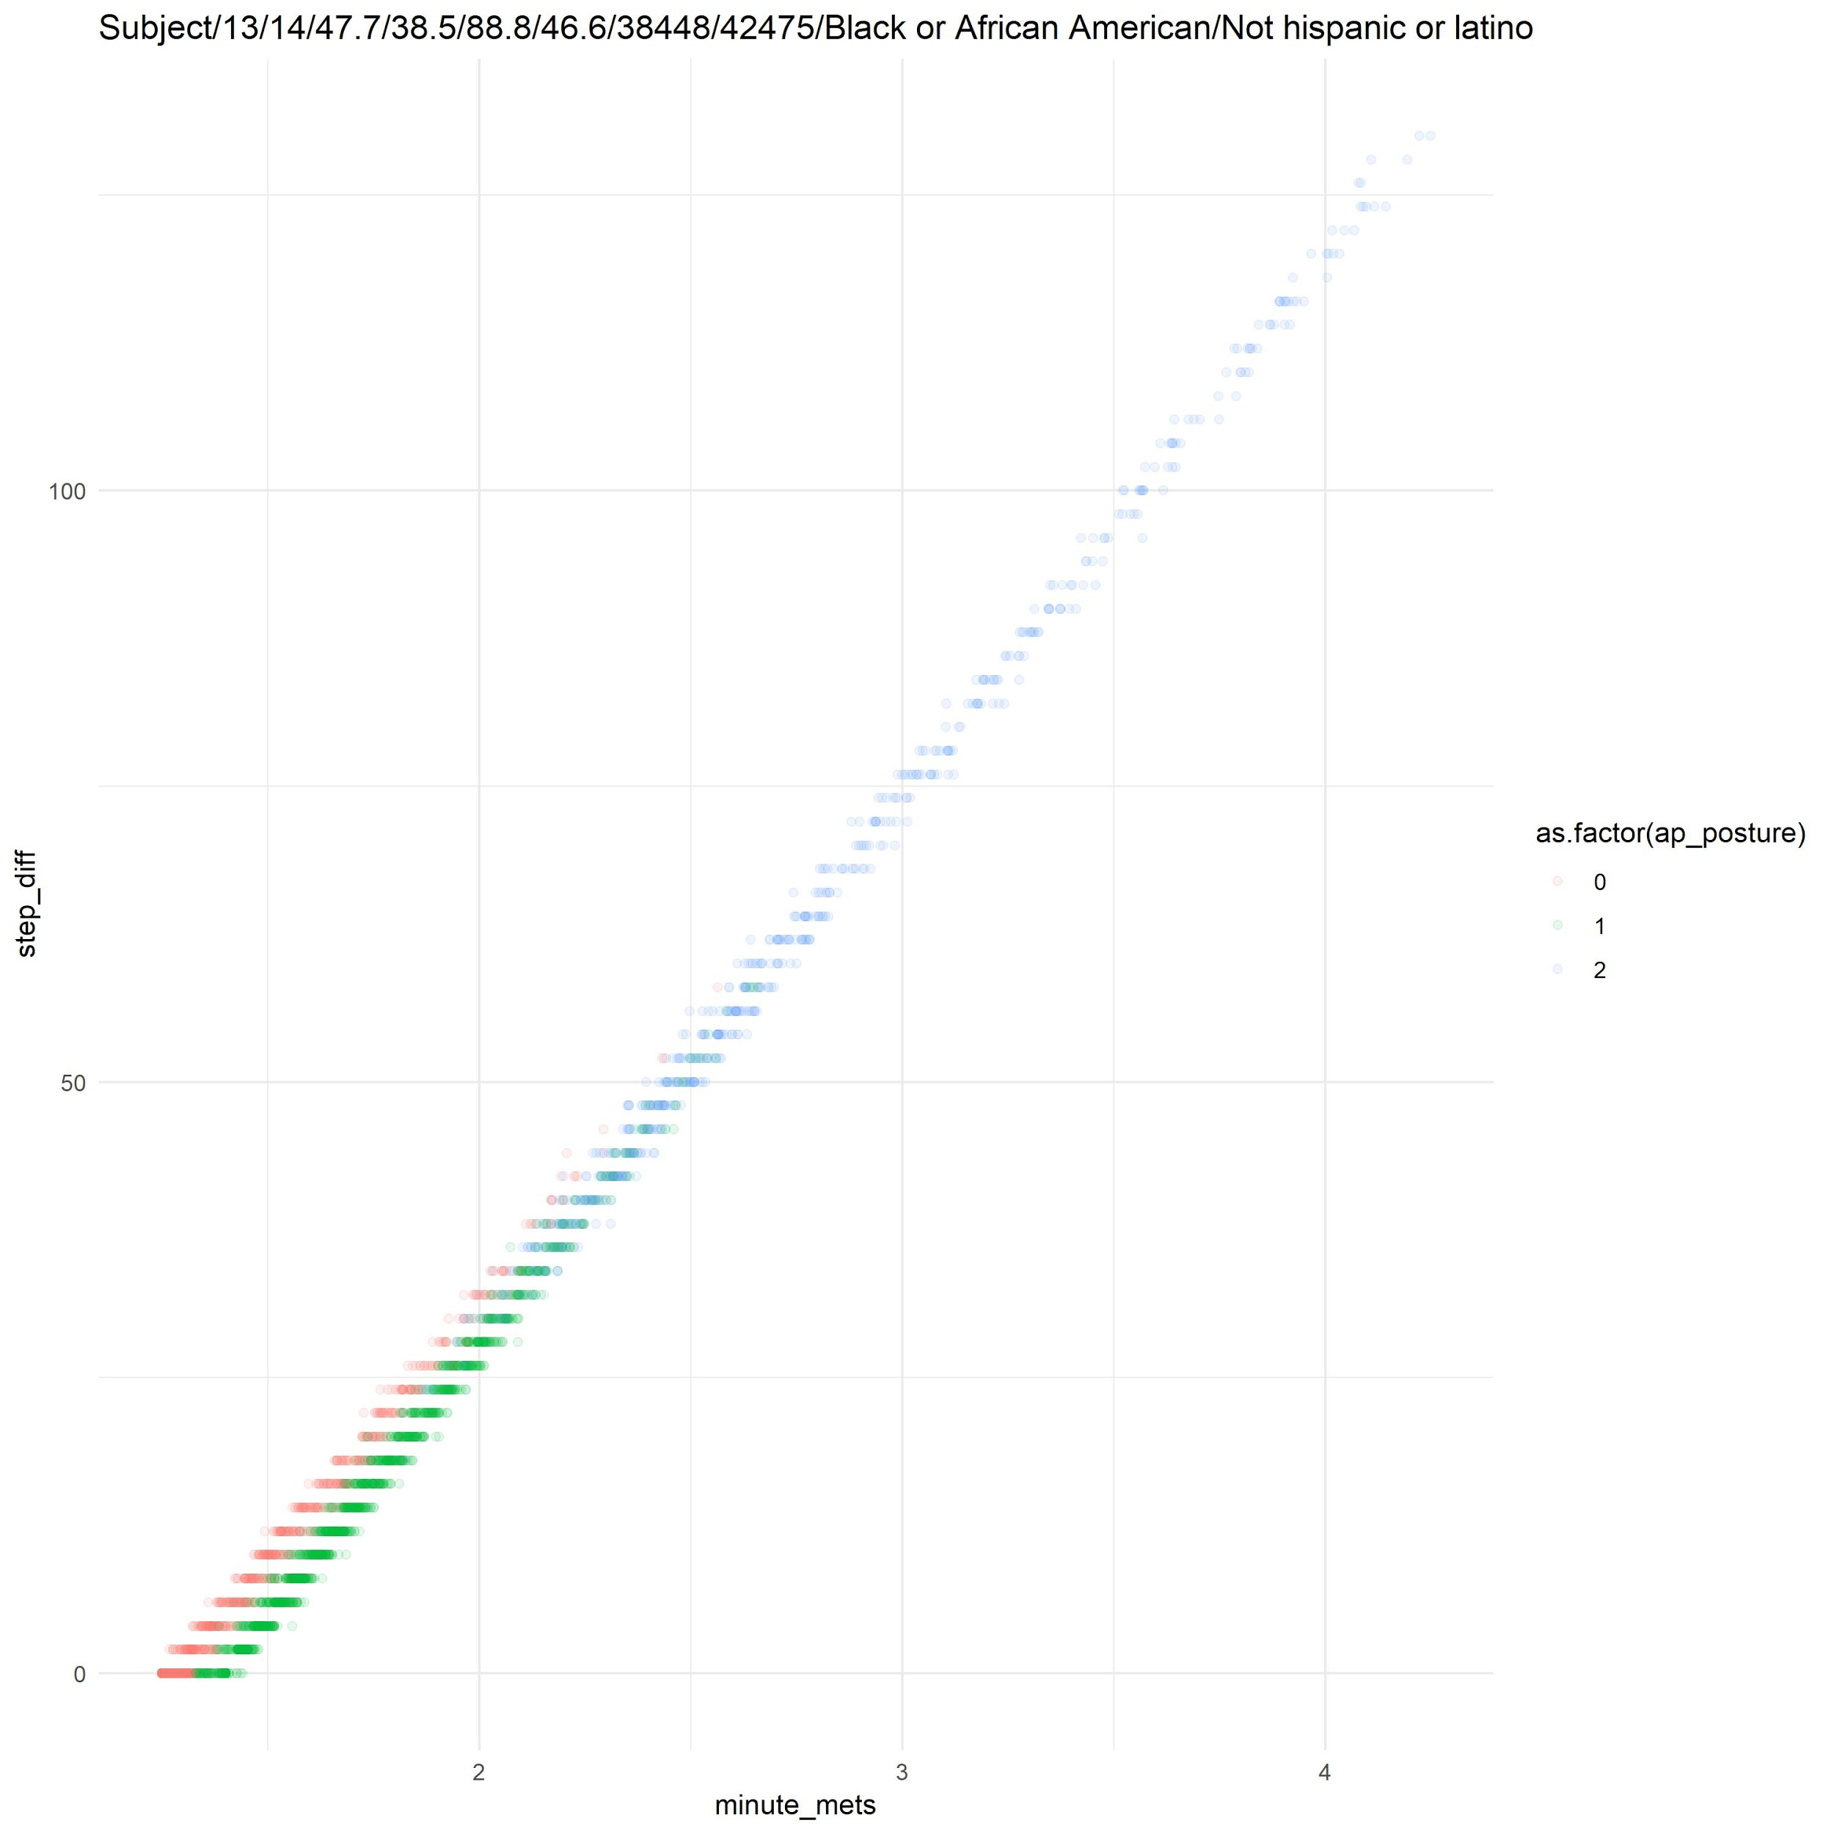
Steps vs. METs
Steps and METs are highly correlated
(>0.98 in most cases)
METs is less sensitive to variation
METs * h⁻¹ = (1.4 * D) + (4 - 1.4) x (C / 120) x D
C=Cadence / minute
D=Activity Duration

Slide 3
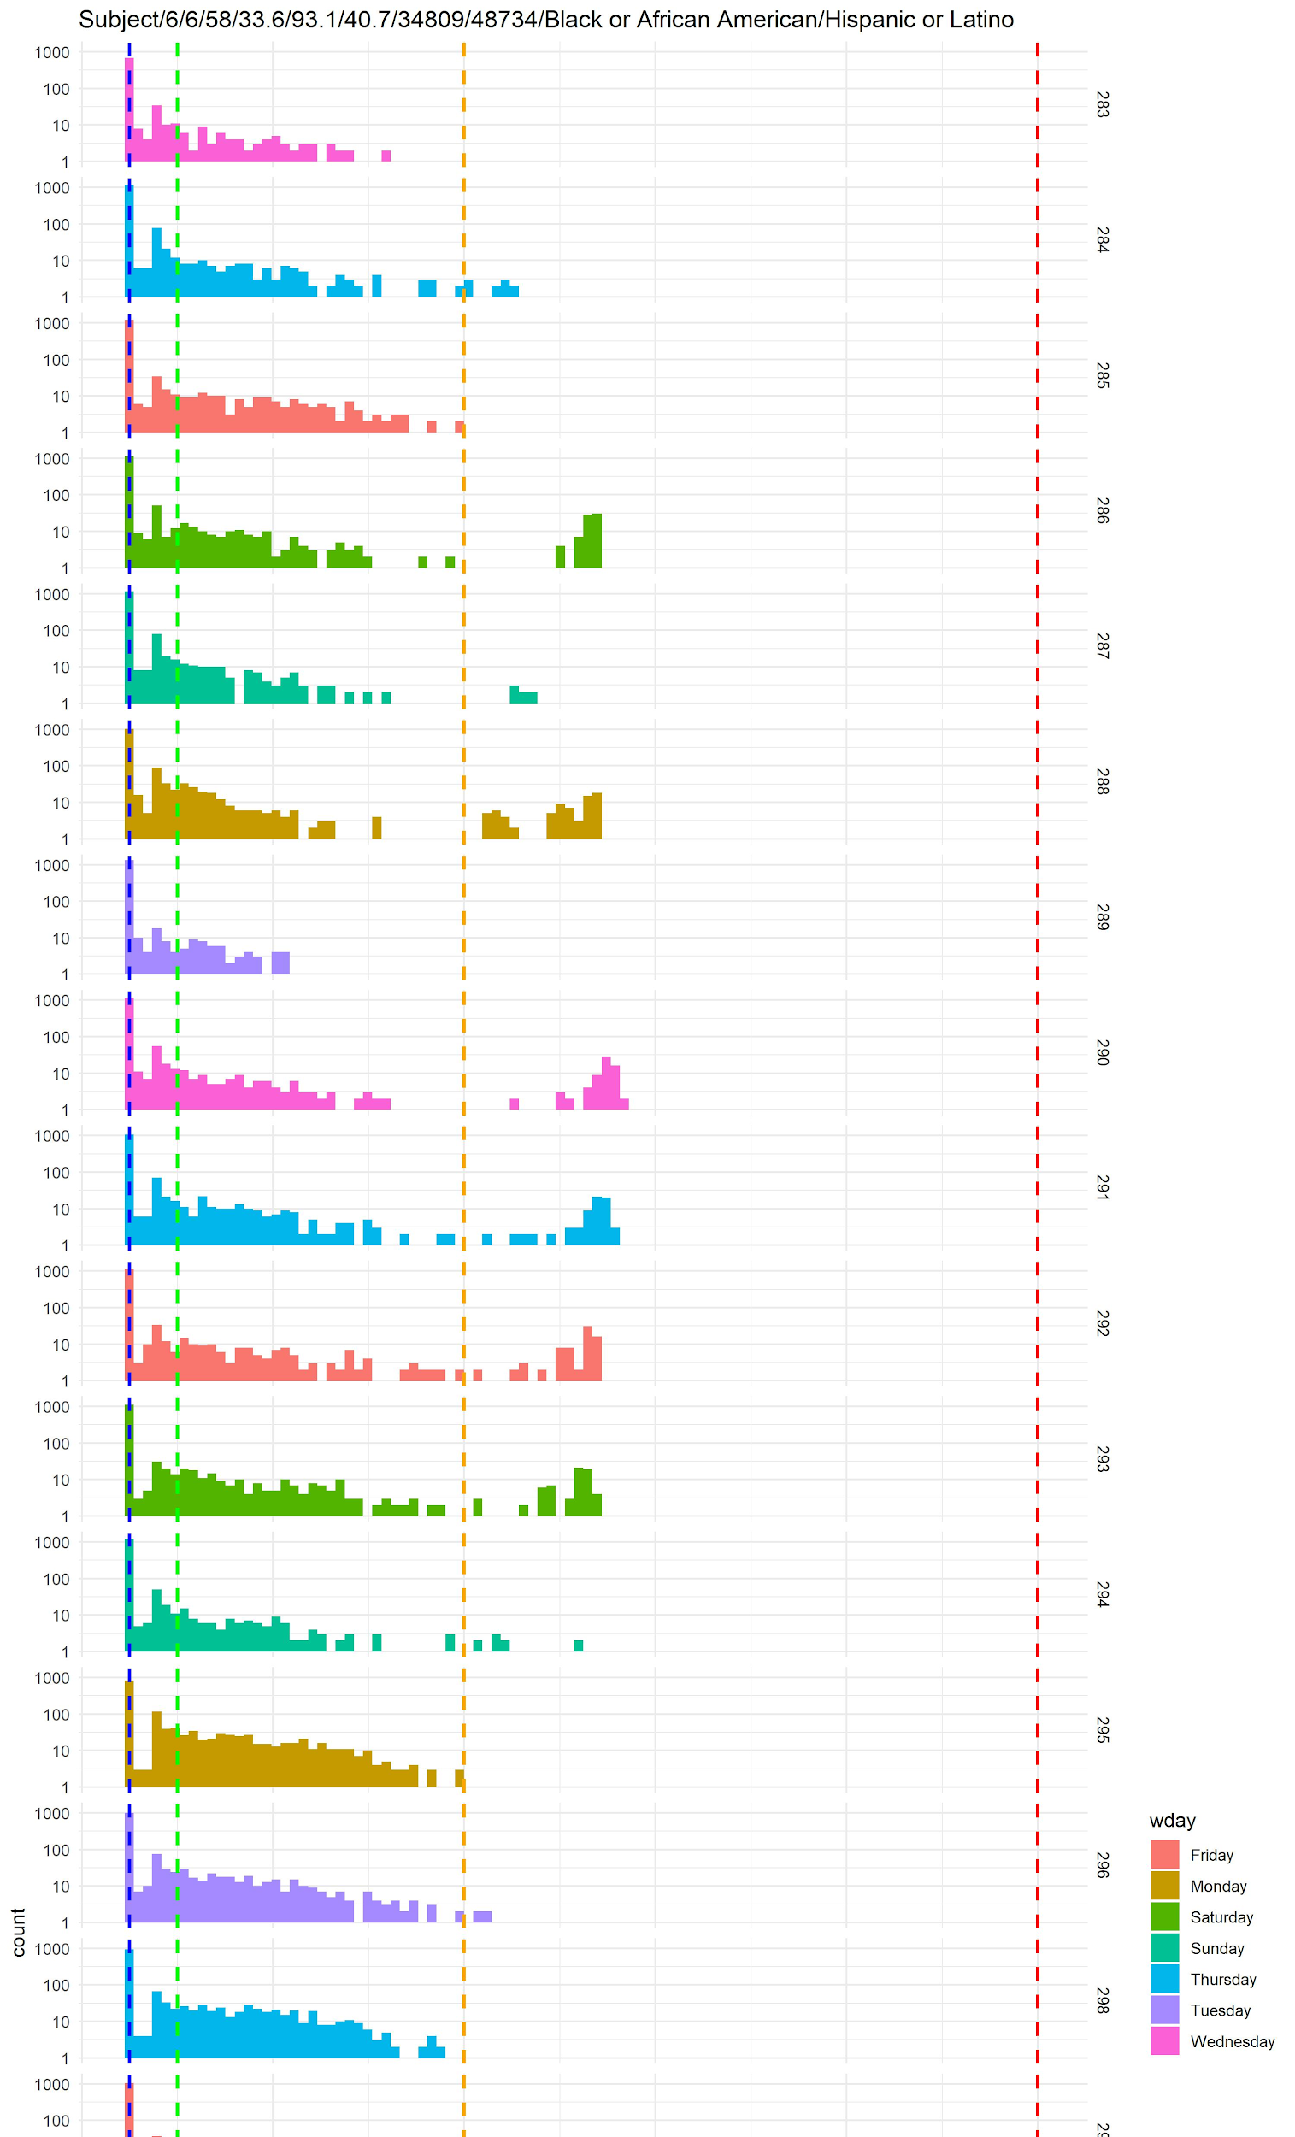
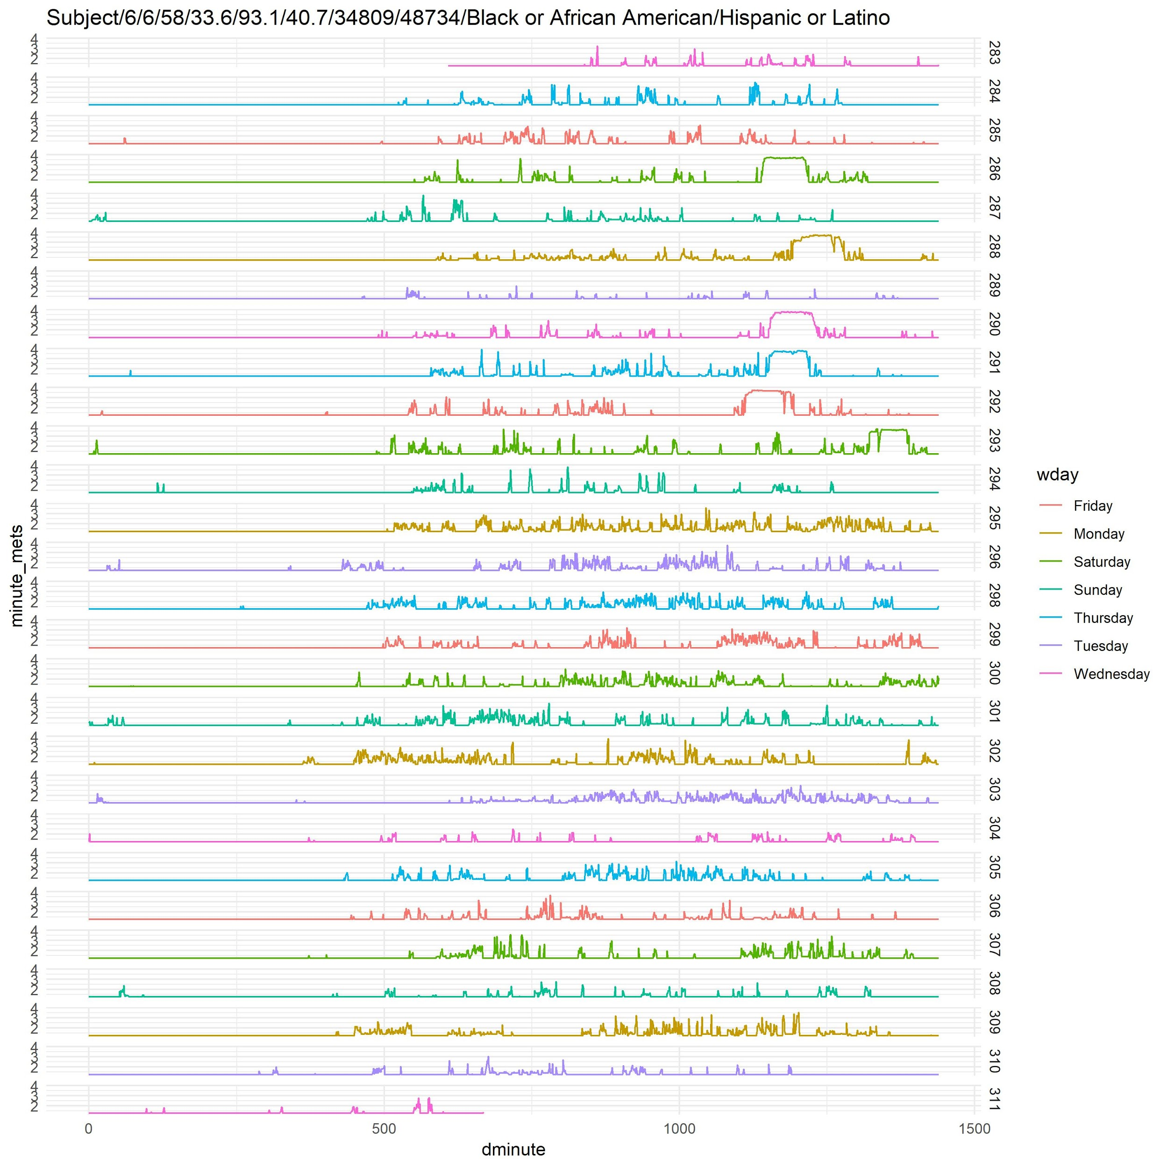
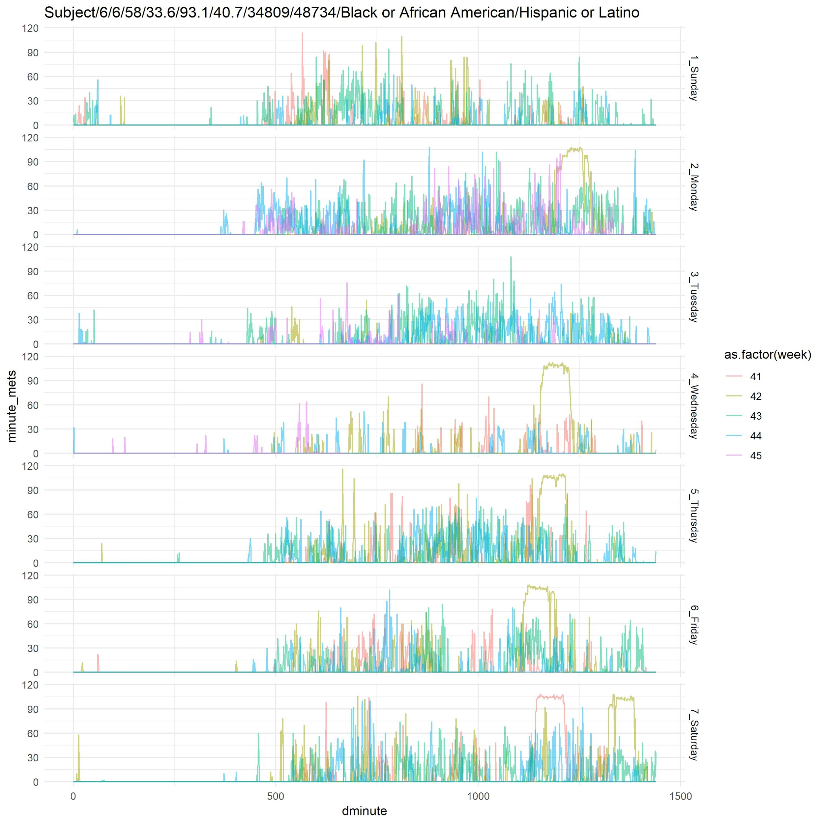
Daily Patterns
count
Questions 3,4,5, 6, 7

Slide 4
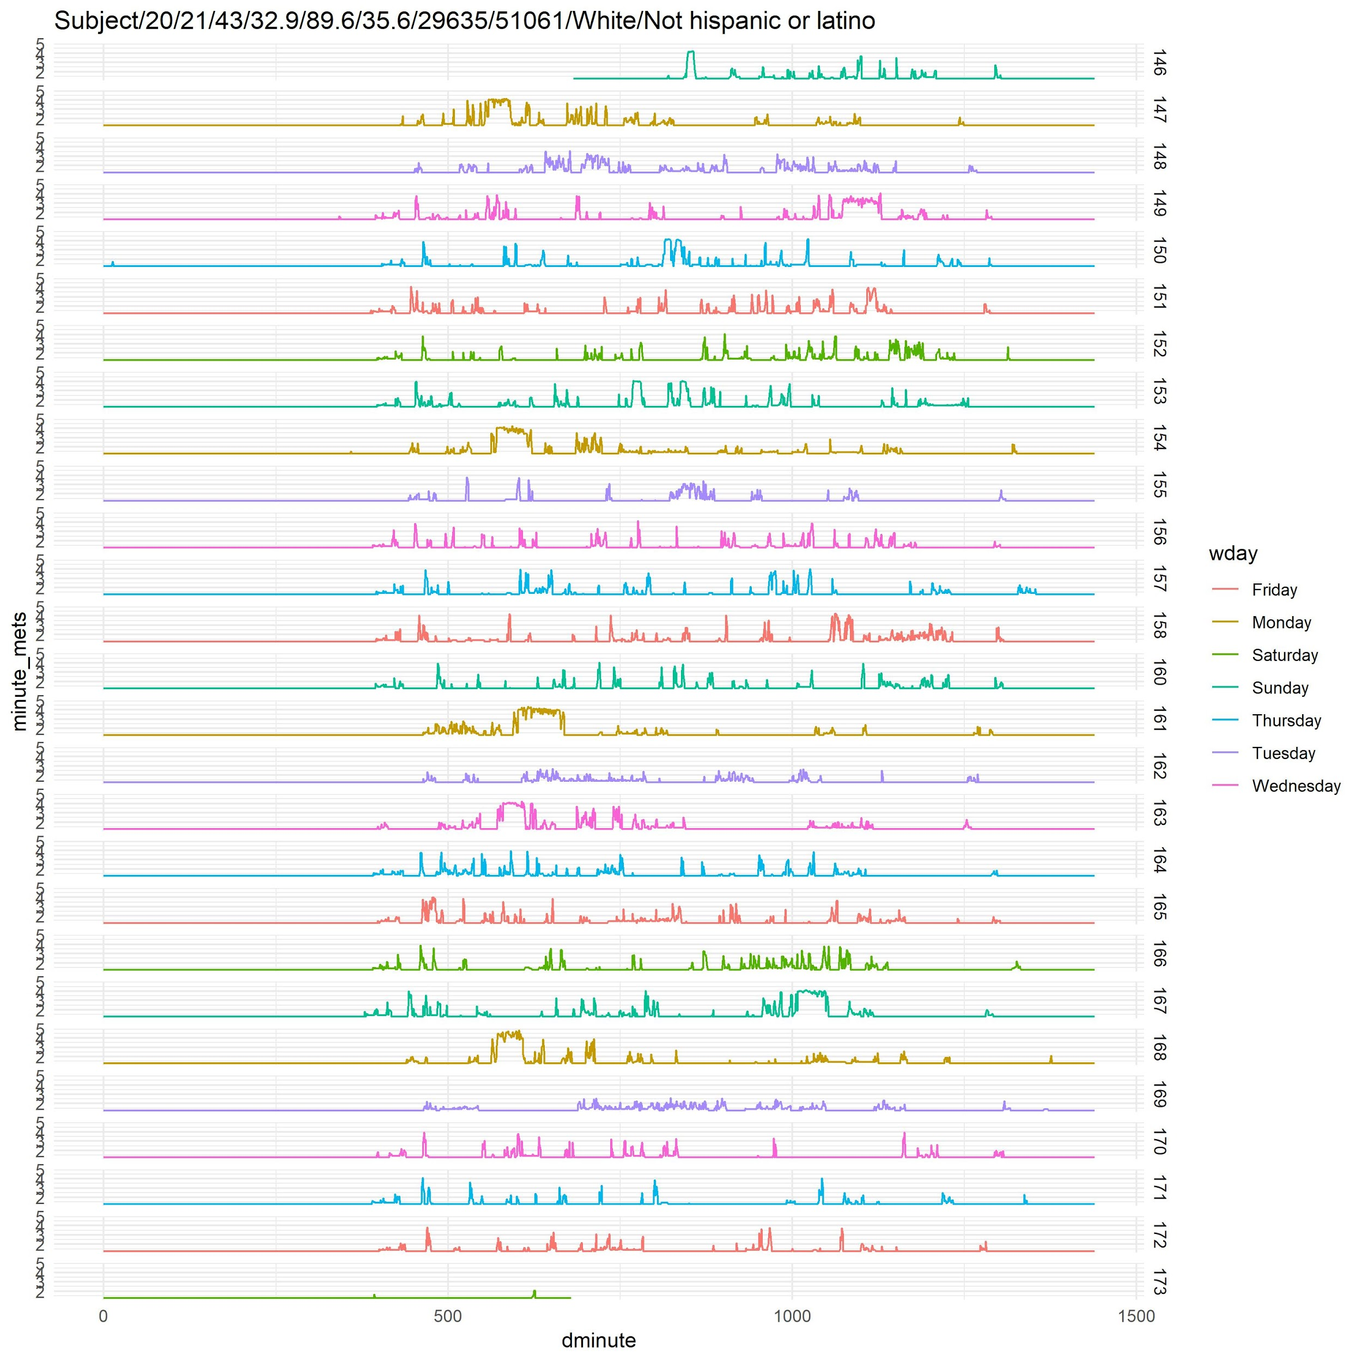
Lifestyle Observations
Questions 3,4,5, 6, 7

Slide 5
Lifestyle Observations
Questions 3,4,5, 6, 7

Slide 6
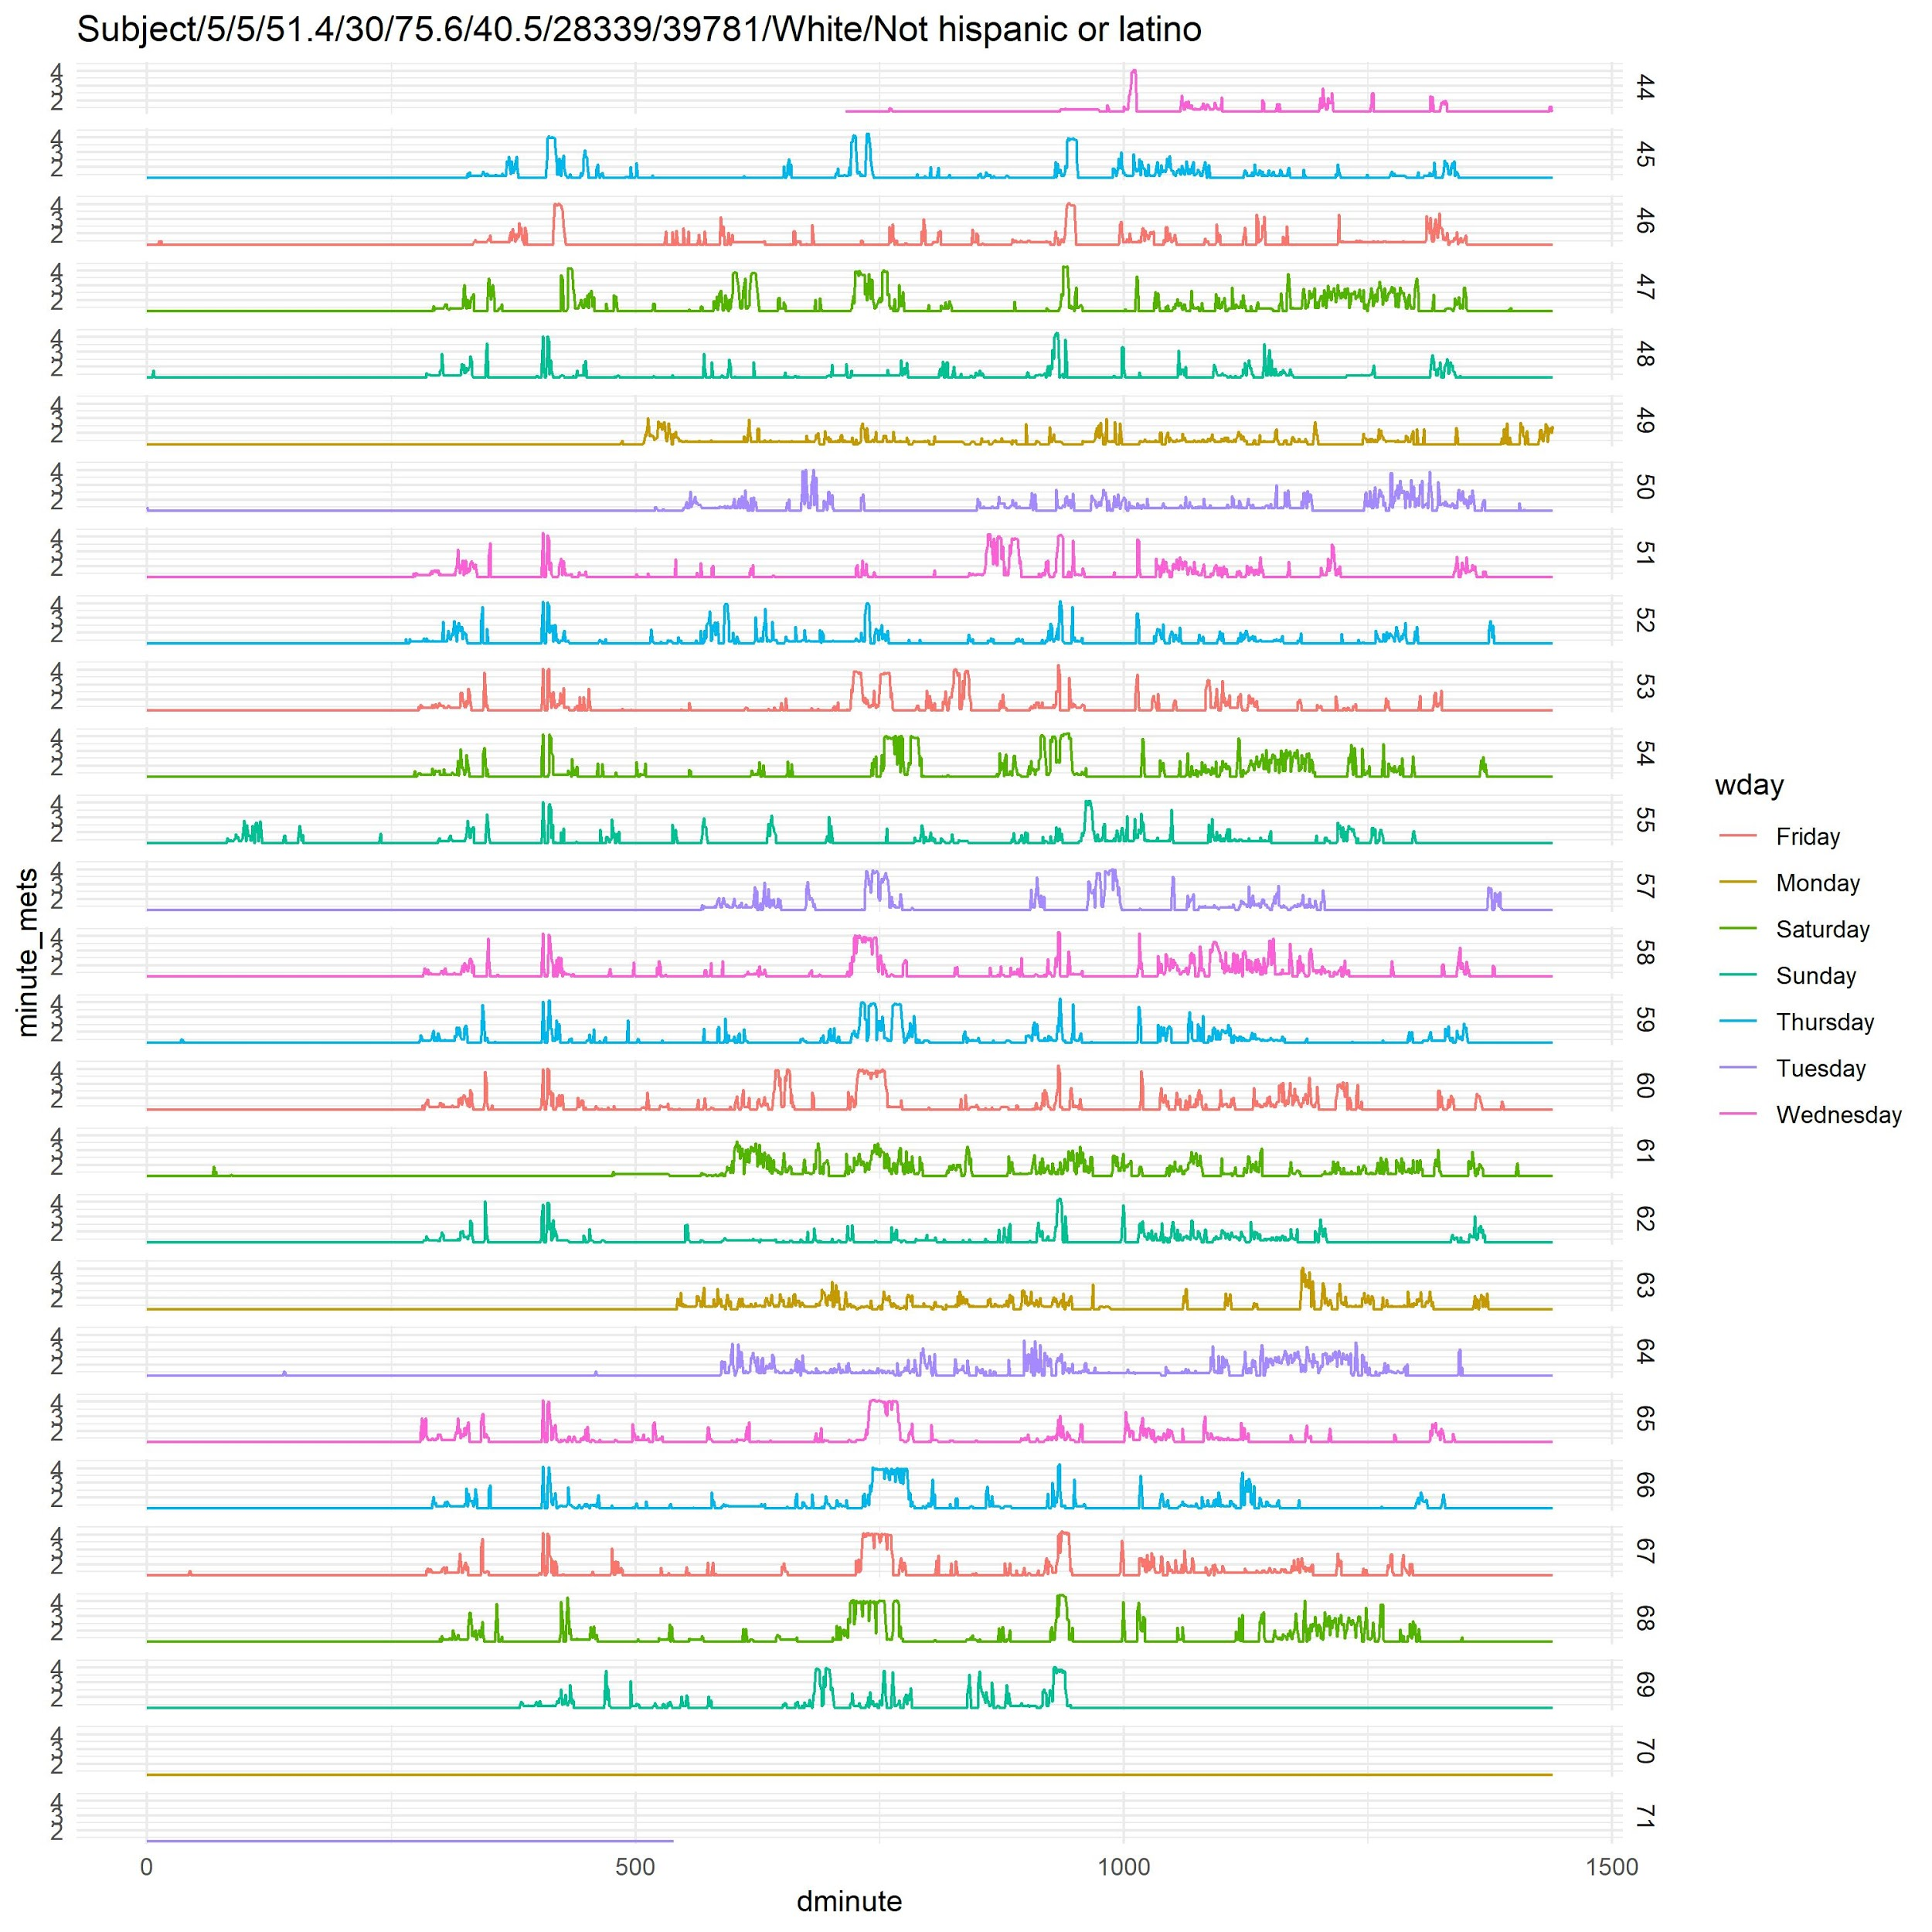
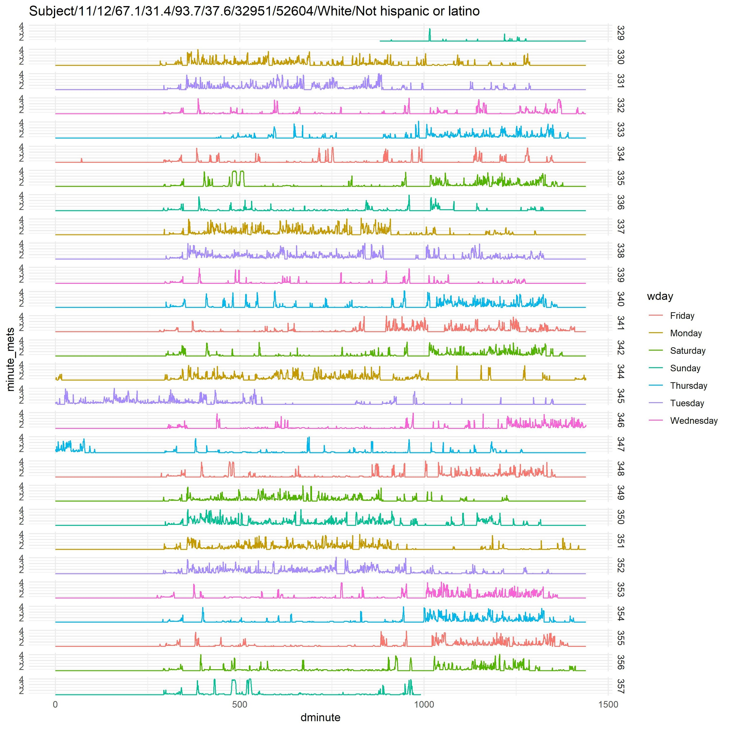
Lifestyle Observations
Questions 3,4,5, 6, 7

Slide 7
Lifestyle Observations
Questions 3,4,5, 6, 7

Slide 8
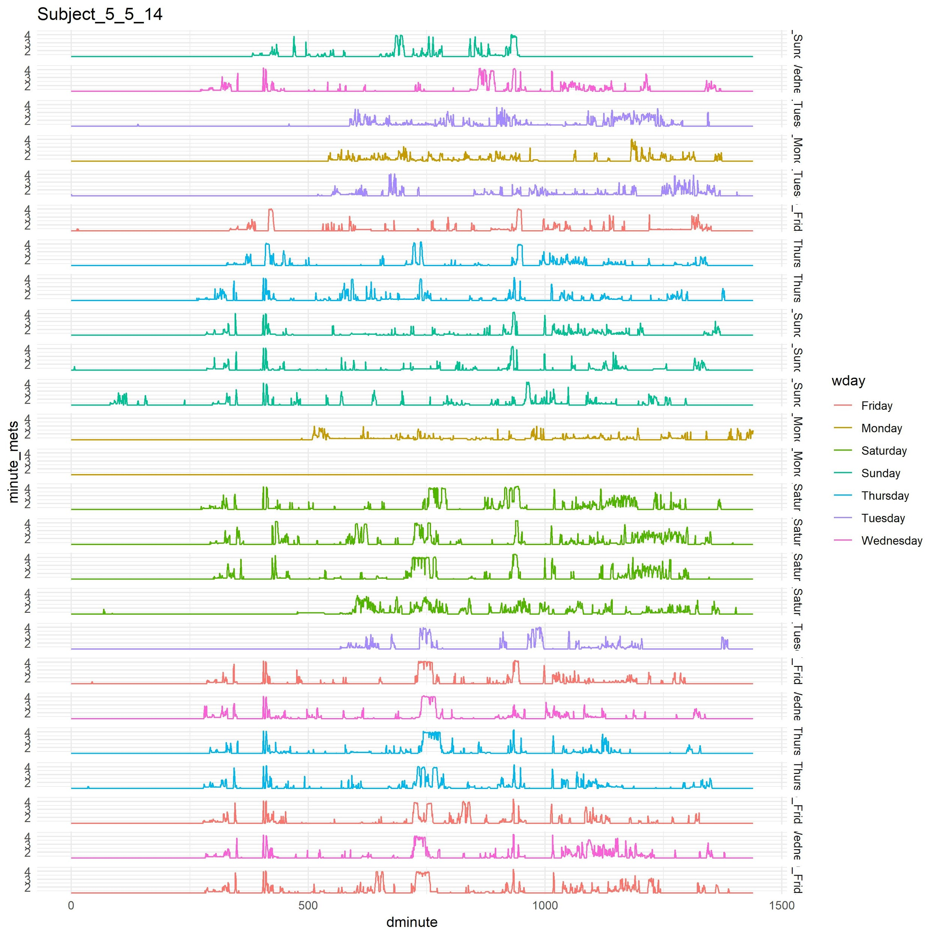
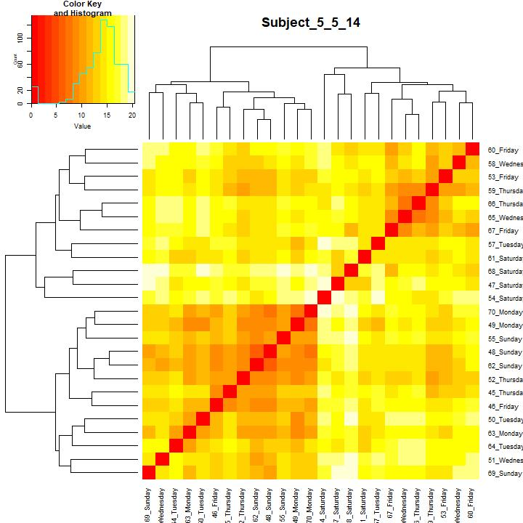
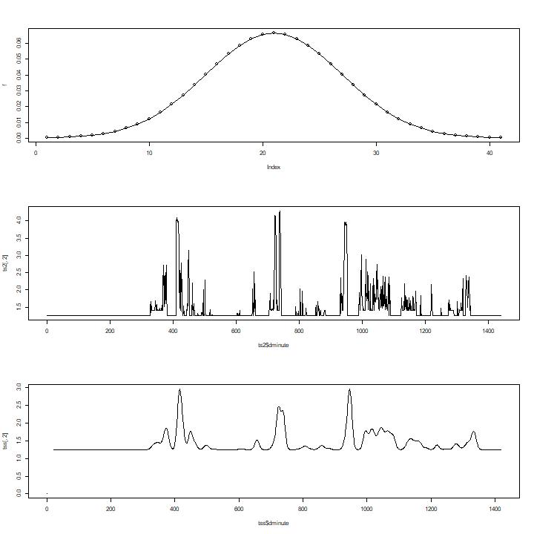
Identifying Lifestyle Consistency
Groups of Similar Days
Smoothing Filter
Day Dissimilarity
Questions: 7

Slide 9
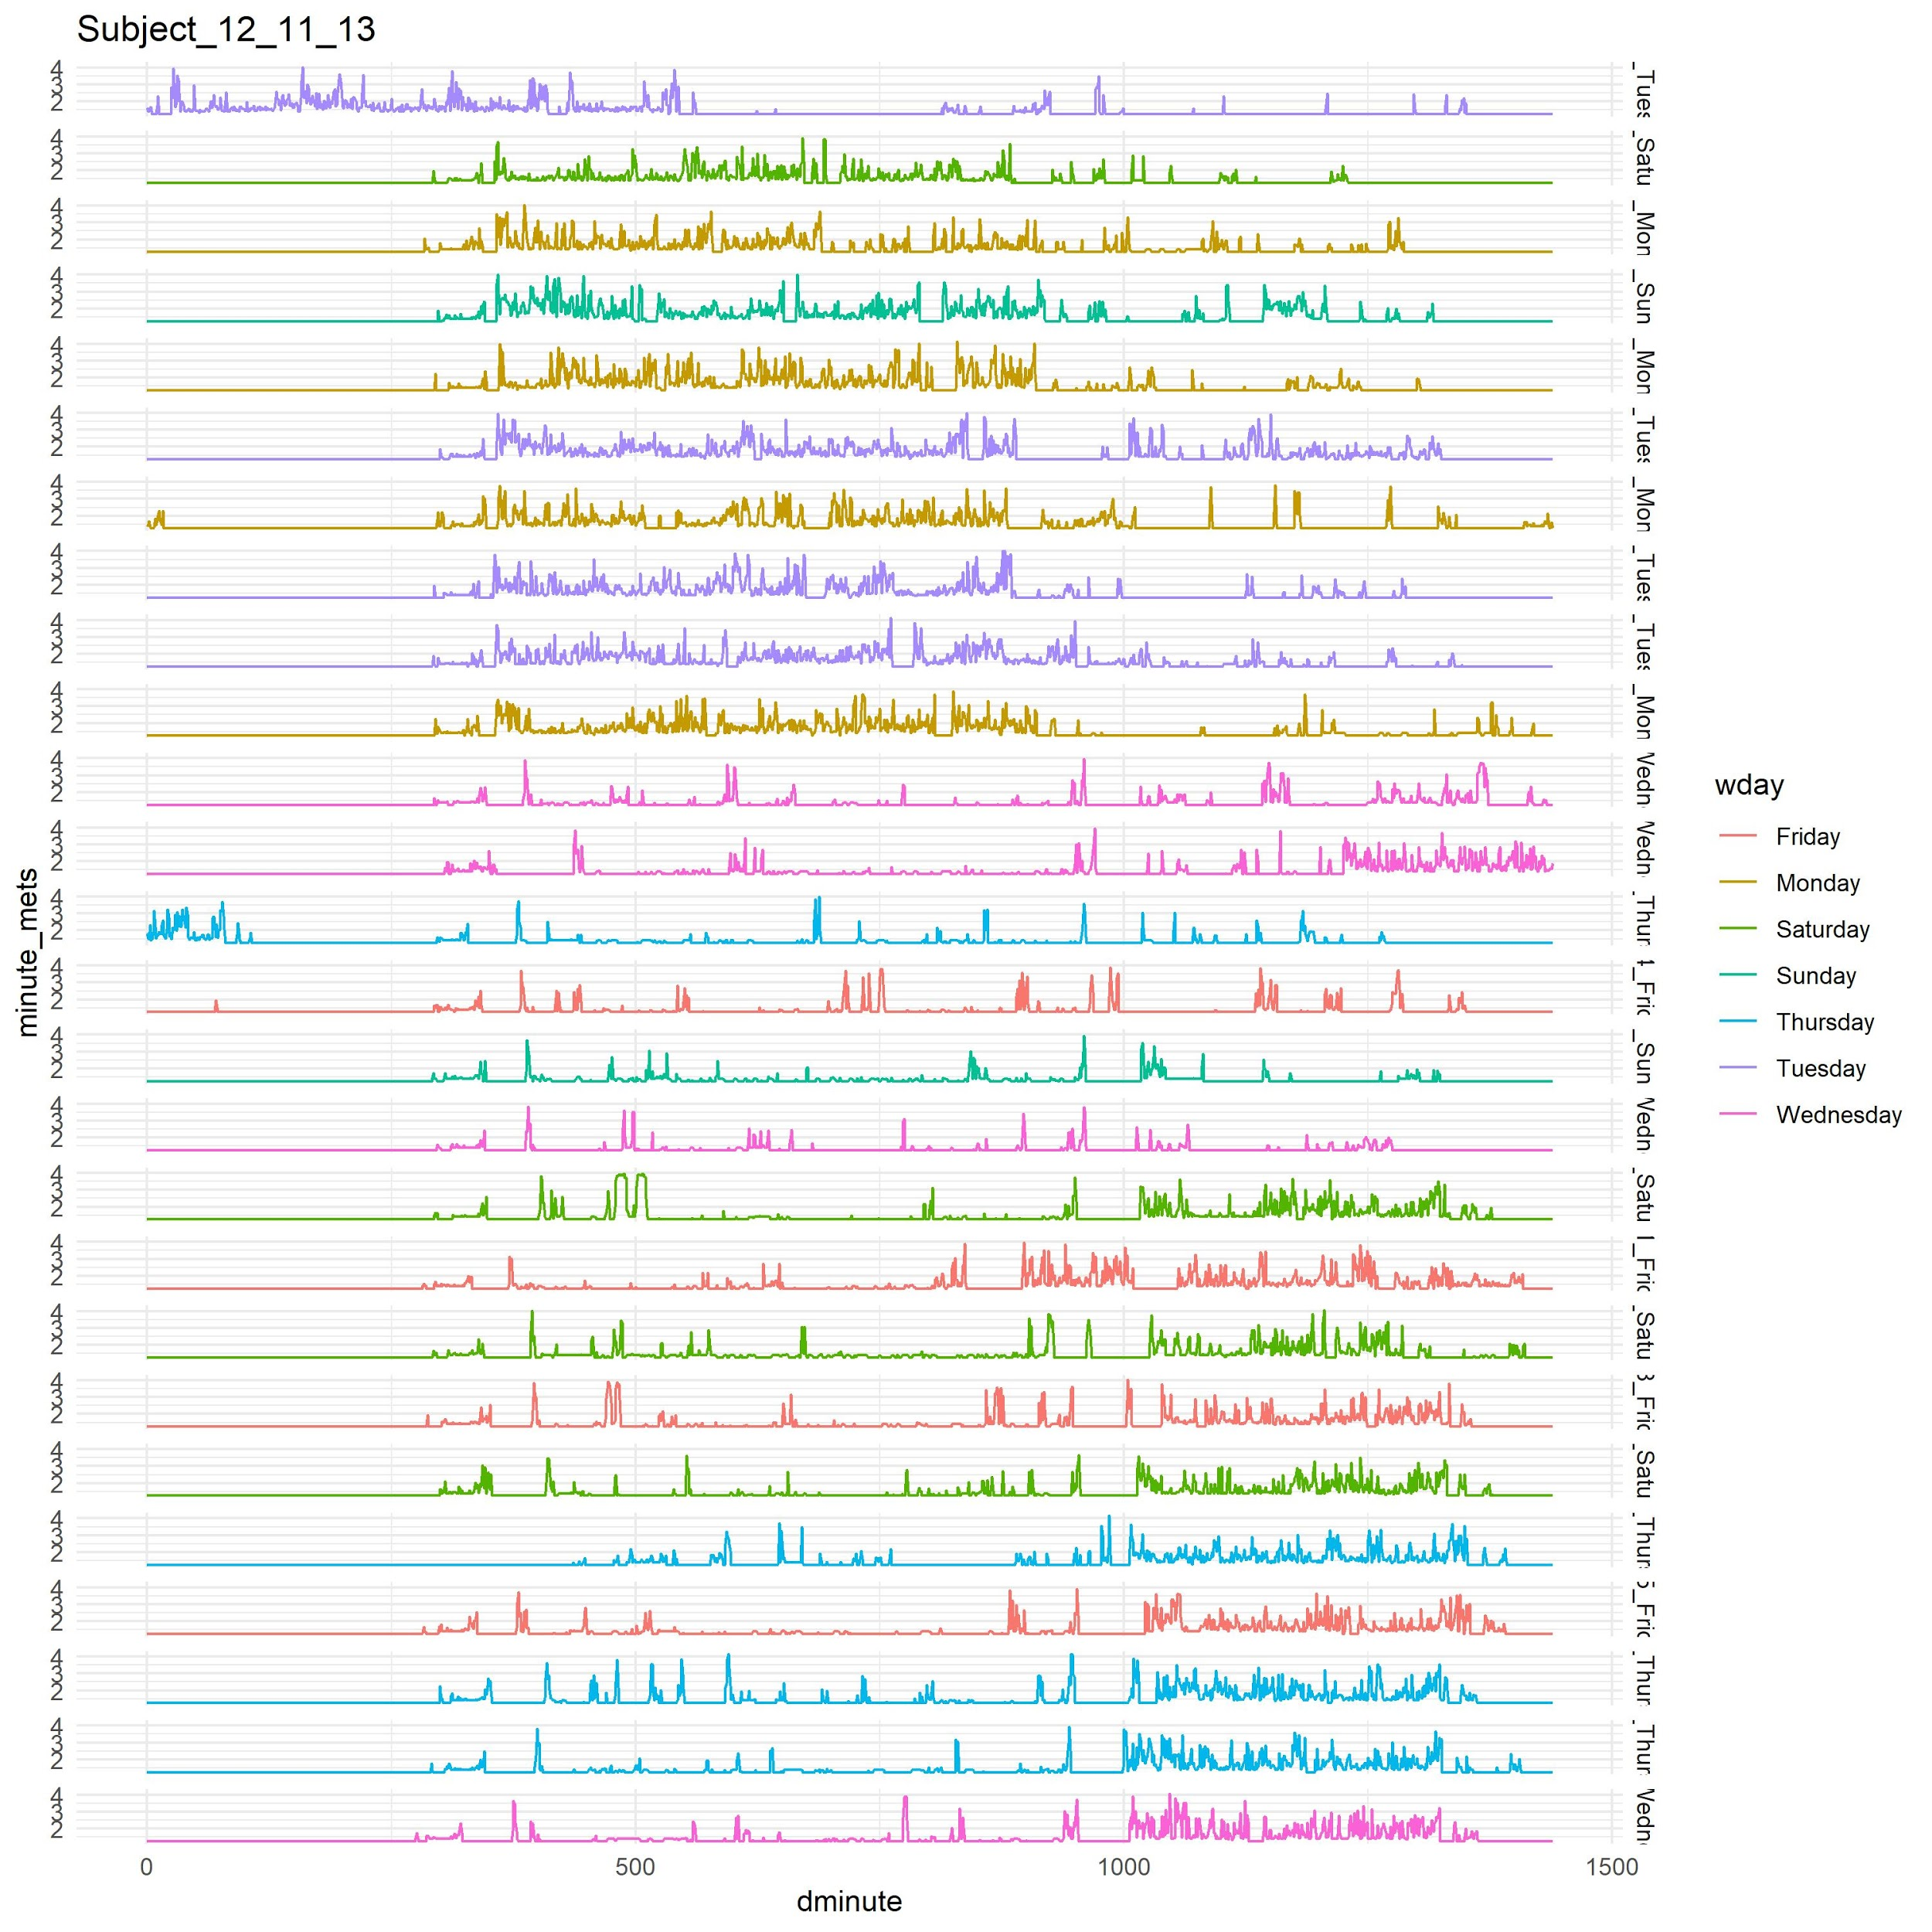
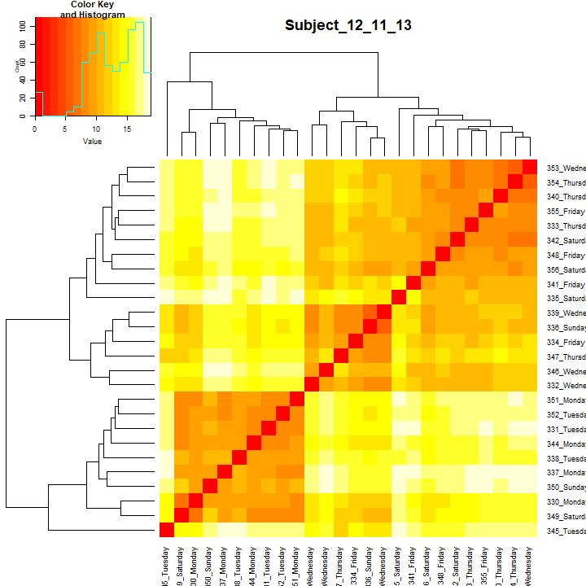
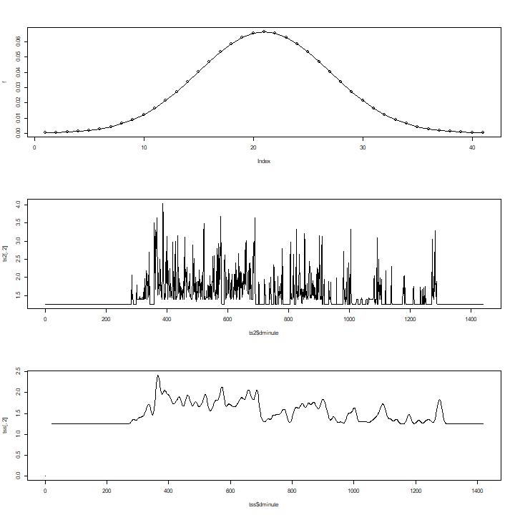
Identifying Lifestyle Consistency
Groups of Similar Days
Smoothing Filter
Day Dissimilarity
Questions: 7

Slide 10
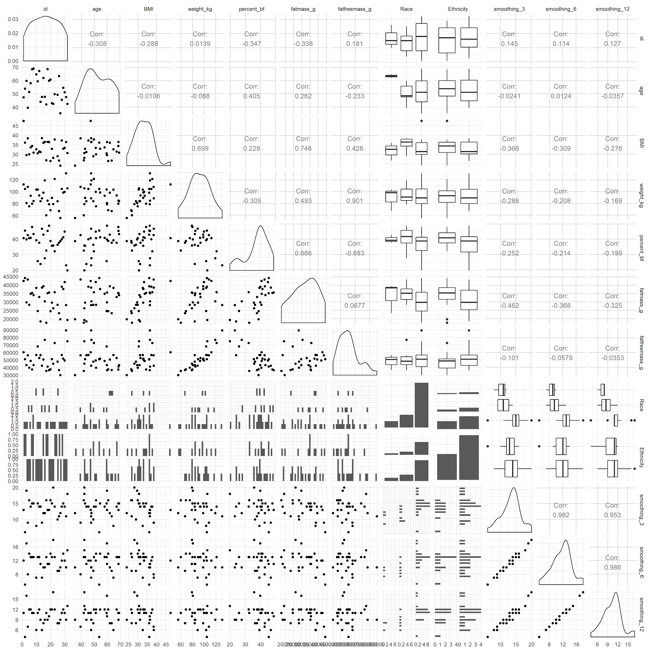
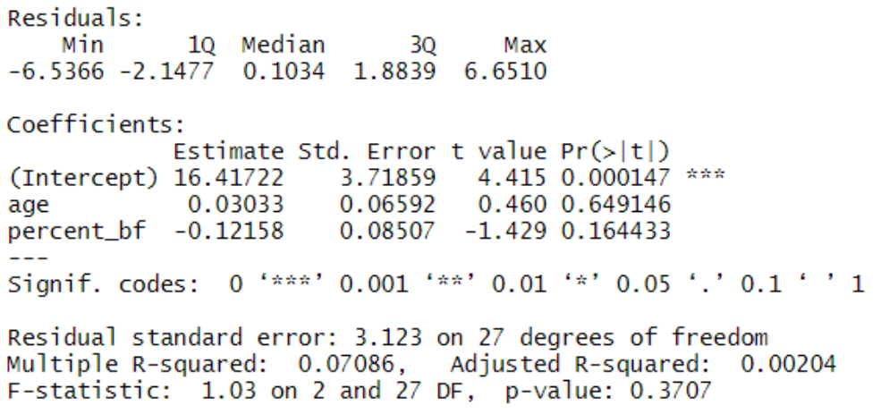
Demographic
Charasterics
Predicting sleep irregularity with demographics:
(failed to show significance)

Slide 11
Activity: More than 1.25 mets.
How we calculate sleep:
At least 10 minutes of 1.25 activity, 0 position.
How we calculate a sleeping period:
Time period separating two intervals is less than 5 minutes of x > 1.25 mets;
For both sleeping periods, no more than 1.25 METS;
Both sleeping periods are at least 10 minutes of uninterrupted 1.25 mets and position 0;
If more than 20 hours of sleep, we drop that day.
Cleaning Data:
Bad Data: the first line of person 22 was excluded.
If a day did not have 24 hours of uninterrupted data, we excluded that day.
ID-9 contained demographic data, but no per-minute data. Data point dropped.
How we defined the start of the day:
The beginning point for a day may change.
It could range from 10:00 pm to 9:59 pm or from 6:00am - 5:59pm.

Slide 12
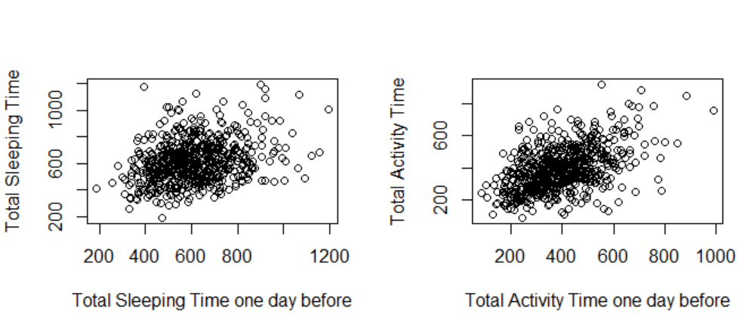
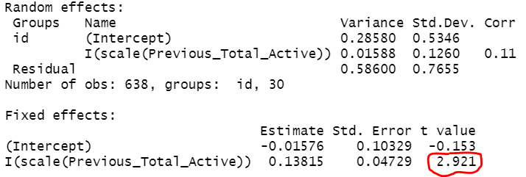
Relations between total sleeping and total activity between consecutive days
Fitting random effects (adjusting variation between person to person), we get the following:
Even after adjustment, the activity of a previous day positively affects the following day.
However, after adjustment, following day total sleep does not seem correlated with previous day total sleeping time
Interesting relationships between sleeping time and activities were not detected.
Assumptions: Only considered the days where the previous day was also full. The new day starts at 11pm.
Summary statistics about activity:
Such dependence can be spurious, because of person to person variability
Questions: 1, 2
Notes:
ASK MANTY ABOUT THIS!!!!!?!?!?!?!?!?! BOTH THE LARGE RED X AND THE FIRST BULLET POINT!
REMOVED FROM FIRST PARAGRAPH: “Even after adjustment, a following day’s activity is positively affected by previous day’s total activities. “

Slide 13
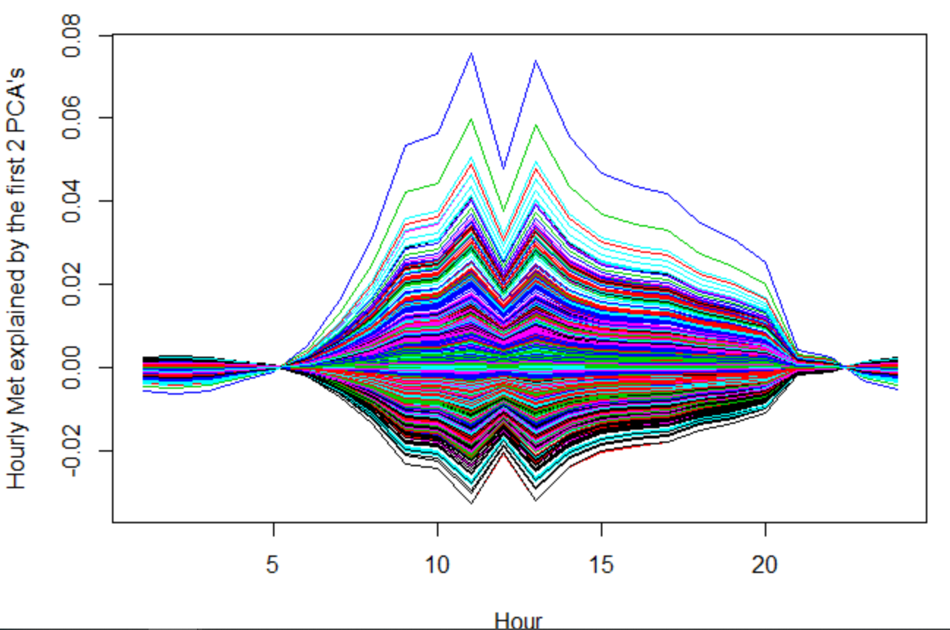
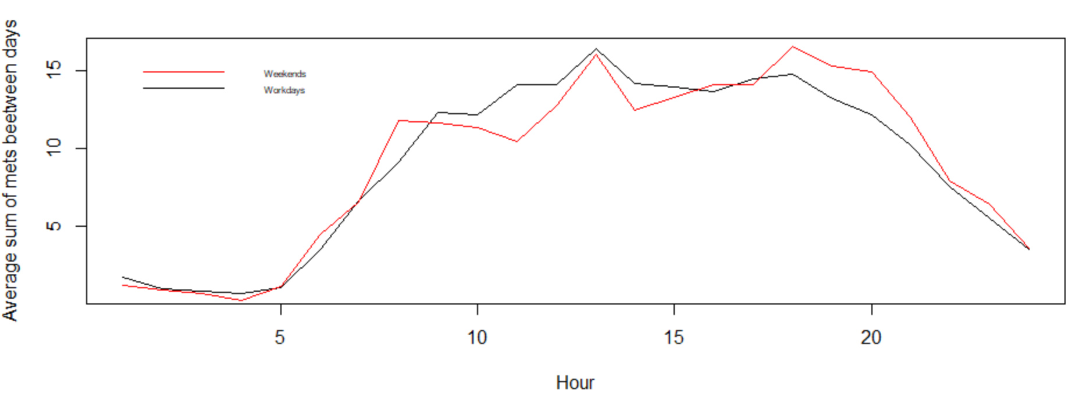
Physical activity accumulation within a day
Assumptions: Day starts from midnight
Activity calculated as sum of (mets-1.25) for a each hour
Only a full days considered
Explaining variability:
First two functional principal components (about 24% of variability)
Mean activity between workdays and weekends
Hour
Questions: 6

Slide 14
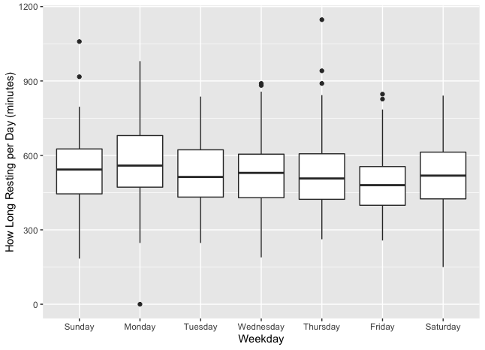
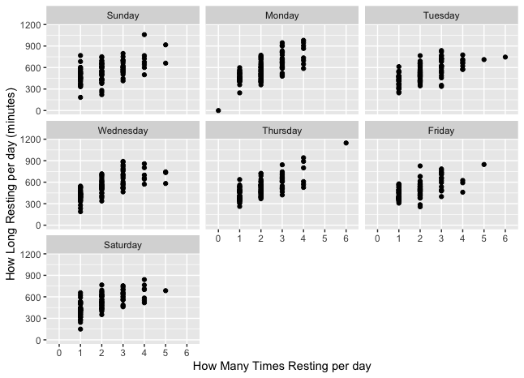
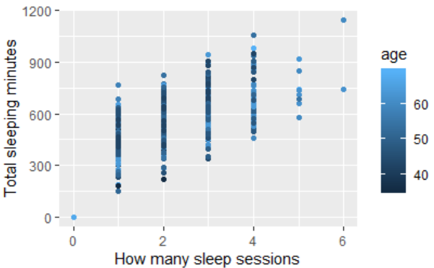
Sleeping Resting time
Assumption: Day time start at noon
Questions: 3

Slide 15
Conclusions
Limitations
Each subject exhibits unique “modes” of daily behavior
Demographics are not very informative
Previous day activity fails to predict next day’s sleep duration
Lack of demographic diversity
Difficulty in determining ground truth sleep
Low power in statistical tests due to sample size

